Slide 1


SMART INDIA HACKATHON 2024
TITLE PAGE
Problem Statement ID –1624
Problem Statement Title- To develop an Artificial Intelligence (AI) based model for electricity demand projection including peak demand projection for Delhi Power system.
Theme- Smart Automation
PS Category - Software
Team ID - SIH125
Team Name – Team 404

Slide 2
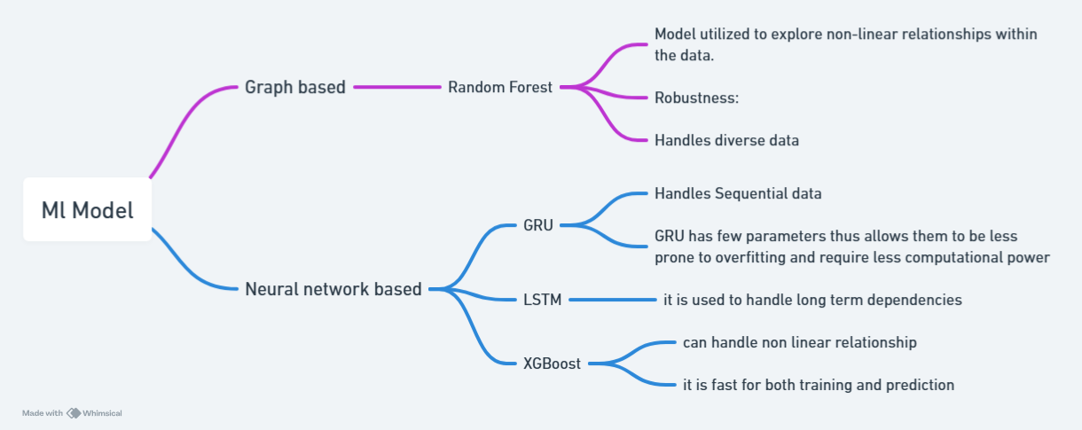
IDEA TITLE
Team 404
Proposed Solution
Solution of the Problem:

Slide 3
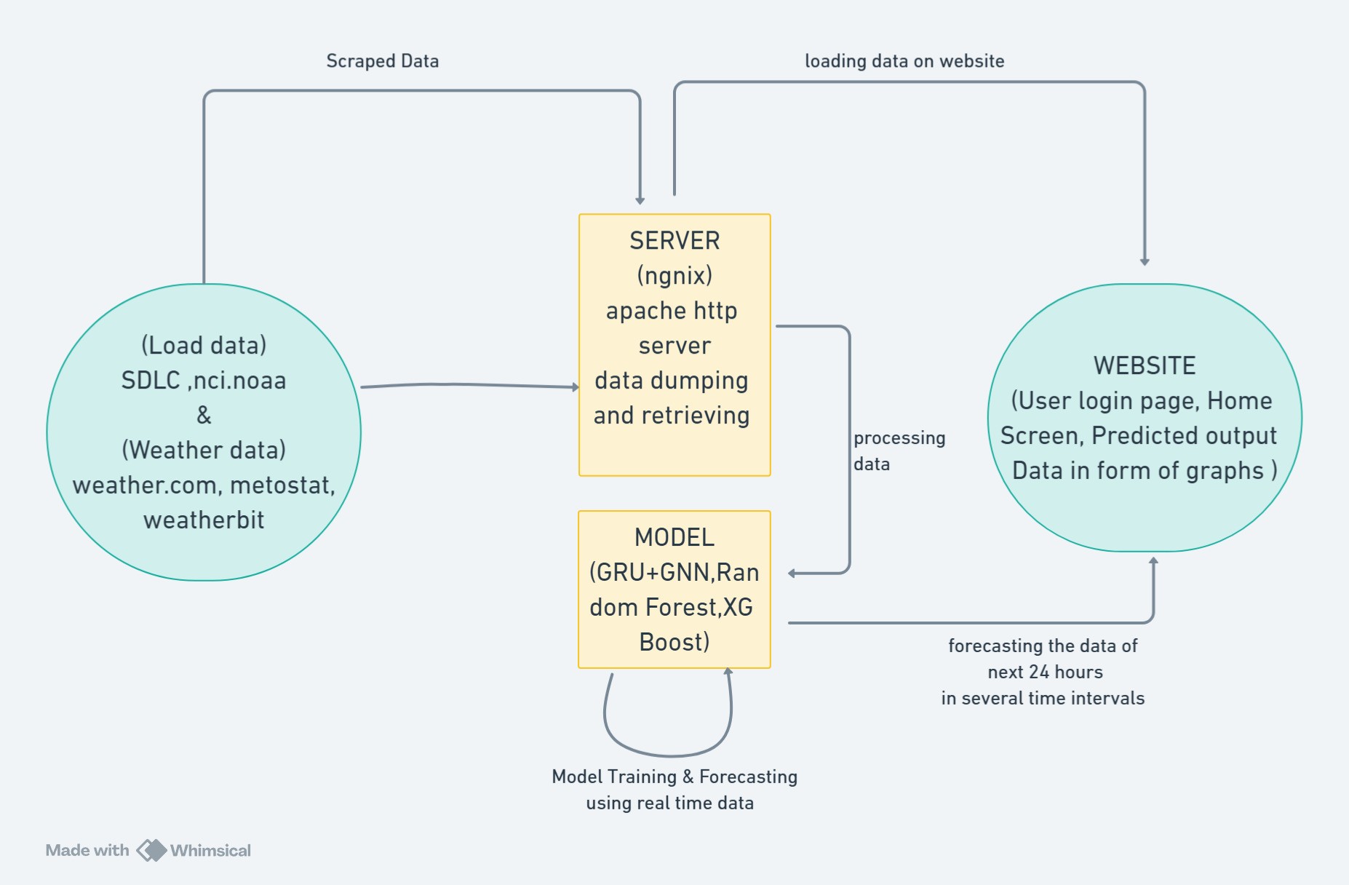
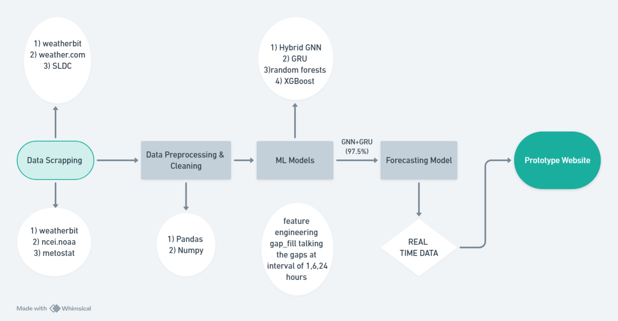
TECHNICAL APPROACH
Team 404

Slide 4
FEASIBILITY AND VIABILITY
Team 404
Analysis of the Feasibility of the Idea:
Availability of Data
Proven AI Techniques
Scalability
2. Potential Challenges and Risks:
Data Inconsistencies
Unpredictable Events
Computational Complexity
3. Strategies for Overcoming These Challenges:
Enhanced Data Collection
Incorporate Anomaly Detection

Slide 5
IMPACT AND BENEFITS
Team 404
1. Potential Impact
More accurate power demand predictions aid in informed decision-making, reducing energy wastage and shortages.
2. Social Benefits
Improved reliability of electricity supply and enhanced quality of life with consistent energy access for Delhi residents.
3. Economic Benefits
Reduced costs for utility and Decrease in energy wastage, leading to lower overall electricity costs for consumers.
4. Environmental Benefits
It has reduced need for excessive power generation, lowering the carbon footprint. Thus, Supports sustainable urban development by managing energy resources effectively based on Delhi's load profile.

Slide 6
RESEARCH AND REFERENCES
Team 404
Energy Consumption Prediction Based on LightGBM Empowered With eXplainable Artificial Intelligence | IEEE Journals & Magazine | IEEE Xplore
Predicting city-scale daily electricity consumption using data-driven models – ScienceDirect
Explainability and Interpretability in Electric Load Forecasting Using Machine Learning Techniques – A Review – ScienceDirect
Electronics | Free Full-Text | A Hybrid Stacking Model for Enhanced Short-Term Load Forecasting (mdpi.com)

